Slide 1



Resume In PowerBI
View in Power BI
Last data refresh:
6/30/2021 6:20:06 PM UTC
Downloaded at:
6/30/2021 6:21:55 PM UTC

Slide 2
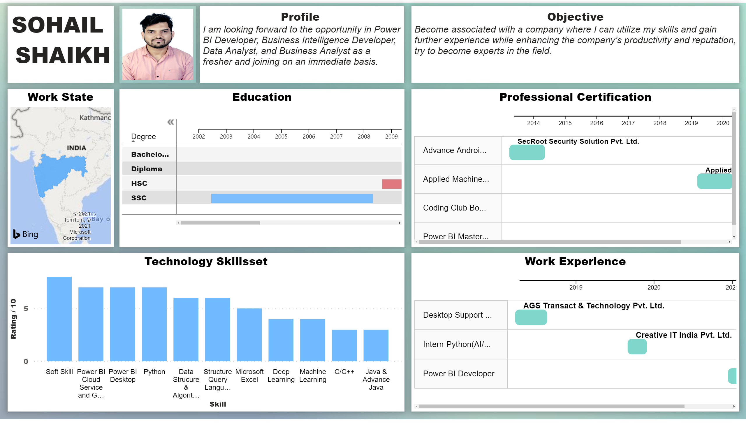
Resume
Notes:
Work State
No alt text provided.
Technology Skillsset
No alt text provided.
Work Experience
No alt text provided.
Professional Certification
No alt text provided.
Education
No alt text provided.
image
No alt text provided.
textbox
No alt text provided.
textbox
No alt text provided.
textbox
No alt text provided.

